Slide 1
Customer Data Analysis
Prepared by: Dinesha K Y
Course: Certified data analyst
Batch id: 11-aug-25-cda-bun-040-wdm1130-ban
Tools Used: Power BI, Excel, MySQL
Dataset: 1000 Customer Transactions (2021–2023)
Dashboards: Executive Summary, Gender Analysis, Age Group Analysis, Category & Payment Method Analysis
Mentor: Datamites

Slide 2
Introduction
This project involves analyzing customer purchase data to understand patterns across gender, age groups, product categories, and payment methods. Using SQL for data extraction and Power BI for visualization, the goal is to generate insights that help in improving customer segmentation, sales strategy, and business decision-making.

Slide 3
PROJECT OBJECTIVE
Understand customer purchasing behavior
Identify high-performing product categories
Analyze sales by gender and age group
Study payment method patterns
Provide actionable insights for business decisions

Slide 4
DATASET OVERVIEW
Attributes
Sourse: Datamites Customer Segmentation Database
Table: customer
Total Records: 1000
Fields Included:
Invoice No
Customer ID
Gender
Age
Category
Quantity
Price
Payment Method
Date
Revenue
Timeline: 2021–2023

Slide 5
Data Cleaning
Performed in Excel + Power BI + My SQL
Removed duplicates
Standardized category names
Created Age Groups (18–25, 26–35, 36–45, 46–60, 60+)
Added measures for:
  Total Revenue
  Total Orders
  Total Quantity
  Revenue by Gender / Age / Category
  Payment Method %

Slide 6
Executive Summary (KPIs)
From Dashboard 1
Total Revenue: 2.37M
Total Orders: 1000
Total Quantity: 2.98K
Total Customers: 1000
Average Order Value: 2.37K

Slide 7
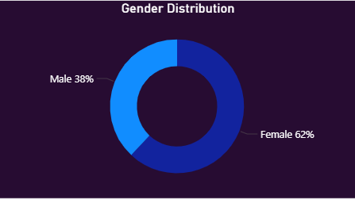
Gender Distribution
Female Customers: 62%
Male Customers: 38%
Female customers generate higher revenue and quantity
Female segment is the major driver of sales

Slide 8
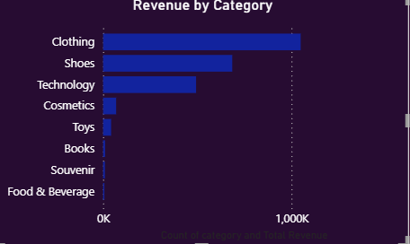
Revenue by Category
Top revenue-generating categories:
Clothing
Shoes
Technology
Cosmetics
Lowest categories:
Souvenir
Food & Beverage

Slide 9
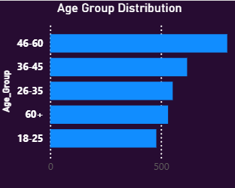
Age Group Insights
46–60 age group has the highest revenue
Followed by:
  36–45
  26–35
  60+
  18–25
Older age groups tend to spend more.

Slide 10
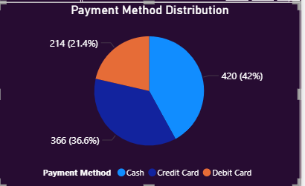
Payment Method Distribution
From dashboards:
Cash: 42%
Credit Card: 36.6%
Debit Card: 21.4%
Cash is still the dominant payment mode.

Slide 11
Gender Wise Revenue & Quantity
Female Revenue: 1.41M
Male Revenue: 956K
Female Quantity: 1853
Male Quantity: 1128
Females buy more items and generate higher revenue.

Slide 12
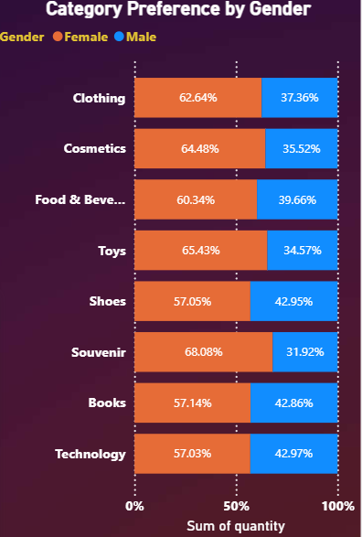
Category Preference by Gender
Female Preferred Categories:
Cosmetics (64%)
Toys (65%)
Clothing (62%)
Food & Beverage (60%)
Male has stronger preference for:
Technology
Books

Slide 13
Age Group vs Category
All age groups show similar category participation
Clothing is bought across all age groups
Cosmetics and Shoes are more popular among 26–45
Toys more popular among older age groups (grandparents buying for kids)
PAYMENT METHOD BY AGEGROUP
Younger groups (18–35): more debit card usage
Middle age groups (36–60): prefer credit card
Older groups (60+): mostly cash

Slide 14
Category & Payment Method Insights
Clothing category has the highest payment volume
Cash contributes the highest revenue
Debit card has the least revenue but steady use
KEY BUSINESS INSIGHTS
Target female customers for higher sales
Improve stocks and offers on Clothing and Shoes
Focus digital marketing on ages 36–60
Increase cashback offers for Debit & Credit Card payments
Low-revenue categories (Souvenir, Food & Beverage) need repositioning

Slide 15
My Sql queries used
(Short version on PPT - full version will be provided separately)
Examples:
1.Total Revenue
SELECT SUM(quantity * price) AS total _revenue FROM customer;
2.Revenue by Gender
SELECT SUM(quantity * price) AS total _revenue FROM customer GROUP BY gender;
3.Revenue by Age Group
SELECT
CASE
WHEN age BETWEEN 18 AND 25 THEN '18-25'
WHEN age BETWEEN 26 AND 35 THEN '26-35' WHEN age BETWEEN 36 AND 45 THEN '36-45' WHEN age BETWEEN 46 AND 60 THEN ‘46-60’
ELSE '60+’
END AS age_group,
SUM(quantity*price) AS total_revenue
FROM customer
GROUP BY age_group;
Note:
Full SQL Queries document is attached separately

Slide 16
Conclusion
This analysis reveals customer behavior across gender, age, category, and payment method.
These insights help the business to:
Improve inventory planning
Target the right customer groups
Increase revenue through optimized marketing
Enhance payment method strategies

Slide 17
Thank You
Prepared by: Dinesha K Y
Course : Certified Data Analyst
Batch id : CDA-BUN-040-WDM1130-BAN

